Slide 1




BUILD AND MAINTAIN A TEAM APPROACH TO SERVICE DELIVERY
D2.TCS.CL5.03
Notes:
Trainer to introduce the unit and explain any rules, procedures etc.

Slide 2

Unit outline
Elements:
Develop service standards
Establish service teams
Work to improve service
Liaise with management regarding service delivery
Lead service delivery team
Notes:
Introduce the unit and take students through the course outline and assessment details.
Ask students to introduce themselves and describe their work setting, role and duties.
Go through all housekeeping details such as fire exits, evacuation procedures, toilet location etc.
Explain that students will also have to complete work projects for each Element/performance criteria and that there will be oral questions and written questions to answer.
Students should be encouraged to keep a portfolio of their work.

Slide 3

Element 1: Develop service standards
Performance Criteria:
1.1 Identify the internal and external factors impacting on the level of customer service to be provided
1.2 Research customer expectations and opinions regarding current level, and expected level, of service delivery
1.3 Integrate research findings into draft service standards
1.4 Liaise with management to ratify service standards
1.5 Produce written service standards for team use
Notes:
Go through the performance criteria with participants.
Ask for any questions.

Slide 4

1.1 Identify the internal and external factors impacting on the level of customer service to be provided
Customer service management has become one of the most important areas of focus for many service industries and the hospitality and tourism industry invests a large amount of time and money on developing customer service initiatives that respond to customer needs
Exceeding customer expectations is the goal for all organisations but it is a challenging task as there are many factors that influence a customer’s experience
In deciding the level of customer service that an organisation will provide, it is first necessary to identify the internal and external factors that influence the customer journey
Notes:
Ask the group to read through the information in the introduction of the Training Manual (TM).
Ask students to describe their workplace and what level their organisation’s service standards are aimed at.
For example, 5 star or 2 star, high level or mid-range.

Slide 5

Internal and external factors
Service delivery concepts that differ from products:
Intangibility
Inseparability
Heterogeneity/Variability
Perishability
Notes:
Explain these concepts) Intangibility, Inseparability, Heterogeneity and Perishability) with participants.
Explain that services are different from products.
Use information from the TM and available online or from resource books.

Slide 6
The product service continuum
The product-service continuum
Pure goods
Pure services
Salt
DVD Player
Fast food
Banking
Consulting
Baked Beans
Air Travel
Car
Tangible Dominant
Intangible Dominant
Notes:
Go through the continuum with participants. Products are more tangible than services.
Ask the group to provide other examples of products and services and where they would be placed on the continuum.

Slide 7

Internal and external factors affecting customer service delivery
Internal factors:
Staff, facilities, equipment, safety, budget, organisational culture
External factors:
Customer profiles, location, business environment, competitors, politics, society and culture
Notes:
Ask students to provide examples of internal and external factors which may influence customer service delivery.
Ask the class to read through their TM and look at internal and external factors that affect customer service.
Ask the class to provide examples of their own or other workplaces where internal/external factors impact on service delivery.
Some external examples could be the economic, social, competitive, political and legal, and technological environment.
Remember to remind students about their work project for this performance criterion and let them know when it must be completed by.
1.1 Write a description of your workplace describing factors that impact on service which could include location, service standard level, facilities etc.

Slide 8

1.2 Research customer expectations and opinions regarding current level, and expected level of service delivery
It is critical for service providers to gather information about the service they provide by researching what customers desire from the service. Research can and should come from multiple sources such as:
Customer feedback forms/surveys
Staff feedback
Competitor analysis
Customer complaints/compliments
Industry research
Notes:
Explain what this performance criterion will look at. Ask students to identify other possible ways of gathering feedback.

Slide 9

Customer definition
Customer: The party who purchase the service you provide although they may not actually use it themselves
Consumer: The party who actually uses the service
Client/Sponsor: The party in whose interest the services are provided
Notes:
Explain the difference between each of the customer definitions.
A customer could be a tour company who purchases room nights at a resort.
The consumer is the person who stays at the resort and the client could be a company who paid the tour company to organise the event for staff.
Ask students to provide other examples.

Slide 10
Customer buying cycle
Pre-purchase
Awareness
Knowledge
Purchase
Selection
Buy
Post-purchase
Trial
Advocacy
Consideration
Satisfaction
Loyalty
Adapted from White and Hockley et al, (2008) From Teacher to Manager, CUP
Notes:
Explain the customer buying cycle. Ask students to work in pairs and talk about a customer buying cycle for their service.

Slide 11

Moments of truth (MOT)
Any time when a customer comes into contact with an organisation or service, they have an opportunity to develop an impression or opinion of the service or organisation. These occasions were called ‘moments of truth’ by Jan Carlzon (1989) who was president of Scandinavian Airlines in the 1980’s.
Notes:
Explain the idea of Moments of Truth. Students can discuss and provide examples from their organisations. These can be external or internal customers.

Slide 12
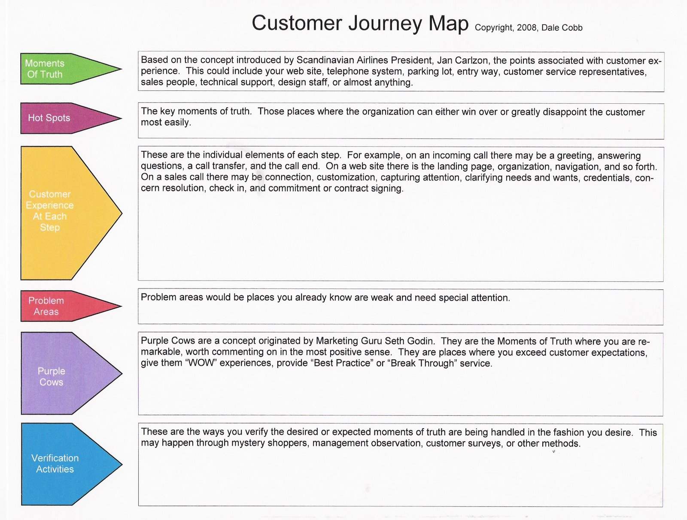
Customer journey mapping
Notes:
Go through the slide with the class. Ask students to work in small groups and to think about a customer journey through their organisation’s service delivery. Which ‘moments of truth’ are the most important?
Trainer should prepare examples such as in dining at a restaurant, booking a hotel room or flight, or someone attending a conference or event.

Slide 13
Observation checklist
Data Collection
Primary |  | Secondary
Observation | Watching customer/staff behaviour and service delivery | Company records | Investigating historical data
Experiment | Testing situations or customer contact areas | Industry associations | Looking at data gathered by industry
Survey | Questionnaires, focus groups, interviews | Government statistics | Utilising government gathered data
Simulation | Recreating a certain customer service context and observing outcomes | Research reports | Various groups may develop reports
 |  | Other published sources | Magazines, journals, academic studies
Notes:
Trainer goes through the slide with students and asks for other examples of data that could be gathered. What feedback information is used at students’ organisations?

Slide 14
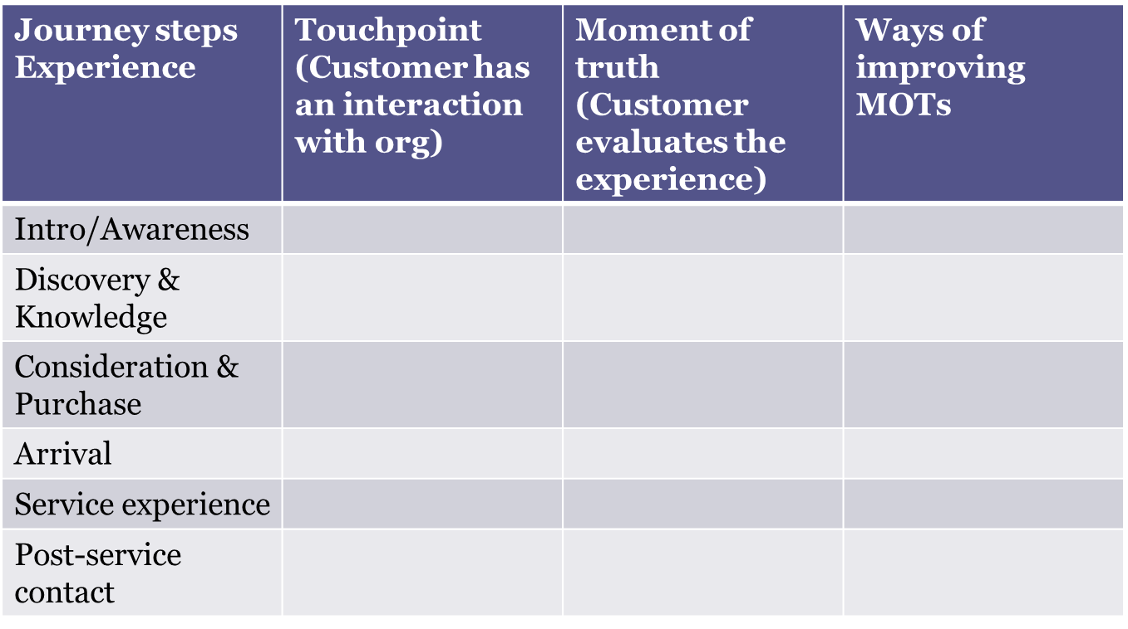
Customer journey mapping
Notes:
Trainer goes through the slide with students and asks them to complete an example for a service oriented process. Trainer could provide an example of a customer getting a spa treatment or flying economy class. Trainer can explore examples on the internet.
Trainer checks examples and students discuss Moments of Truth.

Slide 15
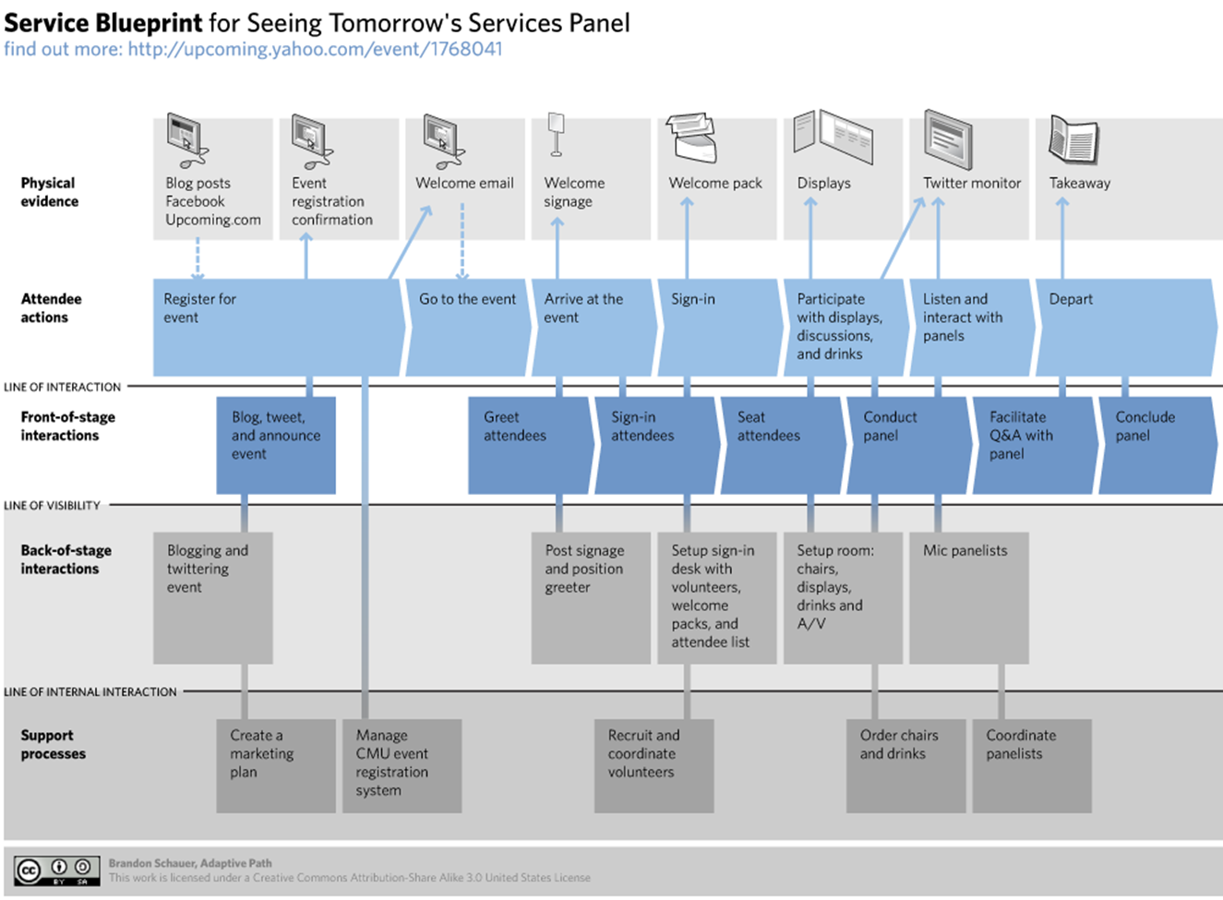
Service Blueprint
Notes:
Trainer explains the service blueprint process looking at front stage and back of stage interactions. Trainer asks students if they have a service blueprint in their department or organisation. Students can search the internet for more examples and present to the class.
Trainer reminds students to complete work project 1.2. This could be done in class and supported by the trainer.
1.2. Map out a customer journey process through your organisation, a part of your organisation or through another service oriented organisation. Use the stages of the customer buying cycle to help you.

Slide 16

1.3 Integrate research findings into draft service standards
Service standards:
Provide a goal for staff or the organisation to concentrate efforts on
Outline a clear set of directions for staff to follow
Set a benchmark that needs to be attained
Allow actual service activities to be measured against desired levels
Help to shape and reflect organisational culture
Notes:
Trainer goes through slide and asks students to provide example of service standards in their workplace.
Trainer provides examples of different standard levels such as different hotel brands within a hotel group: for example, Holiday Inn, Crowne Plaza, and InterContinental = IHG; or Mercure, Novotel, Pullman and Sofitel = Accor. Economy class, premium economy, business and first class in the airline industry. Elicit from students that service standards may be different in each context.

Slide 17

SMART guidelines
Specific: standards should clearly state what they trying to achieve
Measurable: standards should be quantified. For example, ‘A room attendant should be able to clean 8 rooms per shift.’
Agreed: standards should be agreed between all staff and managers
(Continued)
Notes:
Trainer explains the SMART concept and how it applies to the tourism sector.
Students read through service standard examples in the TM and answer the question. What changes could be made to the examples to utilise SMART guidelines?
Trainer asks students to complete activity below. Trainer monitors responses.
Activity
In small groups, discuss examples of service standards at your workplace and/or examples of customer service standards you have experienced. (Restaurants, booking hotels, buying things online, taxis)
Have you ever had to make a complaint or have you given a compliment about service you have received?
Have you received a compliment in your workplace?

Slide 18

SMART guidelines
Realistic: standards should be achievable. A two star resort may not be able to deliver five star service in a restaurant outlet so they shouldn’t develop standards at a level above what they can realistically deliver
Time-bound: a timeframe or deadline should be stated. For example, ‘Emails must be responded to within 24hours of receipt.’
Notes:
Trainer explains the SMART concept and how it applies to the tourism sector.
Students read through service standard examples in the TM and answer the question.
What changes could be made to the examples to utilise SMART guidelines?
Trainer asks students to complete activity below. Trainer monitors responses.
Activity
In small groups, discuss examples of service standards at your workplace and/or examples of customer service standards you have experienced. (Restaurants, booking hotels, buying things online, taxis)
Have you ever had to make a complaint or have you given a compliment about service you have received?
Have you received a compliment in your workplace?

Slide 19

Discussion questions
How often are service standards reviewed in your workplace?
Who organises and manages the review?
Are all people involved in the service delivery asked for their feedback?
Notes:
Students discuss questions and trainer supports the discussion. Students read TM and consider drafting service delivery standards. Have they ever drafted standards?
Trainer brings examples of service standards and asks students to check.
Trainer asks students to develop a draft standard for a service item. Examples could be for any service item in their workplace. They should complete the task in pairs.
Trainer reminds students of work project below and due date.
1.3. Bring to class two examples of service standards from your workplace or from service organisations. These could be found in Operation Manuals or online.

Slide 20

1.4 Liaise with management to ratify service standards
Meeting with management:
After drafting a service standard statement, management will need to review the draft and to offer input or advice before the service standard will be agreed to
Notes:
Trainer goes through slide and explains the need to involve management.
Students read through TM and trainer explains that trainees should be well-prepared before they present a draft service delivery standard to management.

Slide 21

Discussions with management
When presenting service standards to management, ensure that:
Draft service standards are written clearly
Standards are based upon ‘SMART’ criteria
Feedback has been gathered from internal and external customers
Feedback and evidence from staff, industry examples and external customers has been incorporated into the draft standards
(Continued)
Notes:
Trainer goes through slide with trainees. Trainees check information and provide comments.
Trainer reminds trainees of work project and due date. This could be done in class or as homework.
1.4. Write about an example where you have shared a suggestion or feedback with management. Outline the context, what the suggestion was and the outcome.

Slide 22

Discussions with management
When presenting service standards to management, ensure that:
Background is provided for management on why service standards are at the described level, need to be updated or continued at existing levels
Any suggested inclusions or changes are clearly supported with evidence
Management is provided with an opportunity to respond and offer feedback
Service standards reflect and incorporate organisational goals, beliefs and desired levels as well as meeting customer expectations
Notes:
Trainer goes through slide and explains that accessibility to service standards is critical for team members to deliver service at the expected level.

Slide 23
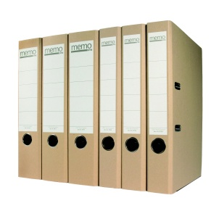
1.5 Produce written service standards for team use
There are many things that should be considered when developing written standards that relate to the document itself.
The service standards need to be accessible and easy to identify. This is extremely important as a document that cannot be accessed is just information
Written service standards that are easily accessible help to make these standards an integral part of the organisational culture and service delivery
Notes:
Trainer goes through slide and explains that accessibility to service standards is critical for team members to deliver service at the expected level.

Slide 24

Producing written service standards
Write clearly and use language which is simple to understand
Use a logical, step by step format
Make sure the standards align with company policies, guidelines and mission
Name the files clearly and logically so people can easily find the service standard they require. Store them effectively. If service standards are stored electronically they must be stored effectively so other staff can find them easily. Using folders and sub-folders can assist
Include a section which identifies when the standard was created, who created it, which is the latest version and when it is due for review
Notes:
Trainer brings shows students examples of service standards. These can be obtained from the workplace or from examples from the internet. Trainer could ask students to bring in examples from their workplace.
Trainees read through the slide/TM and ask questions.
Trainer reminds students of work project and due date.
1.5 Provide three examples of service standards that your team uses.

Slide 25

Summary
There is a process that needs to be followed when developing service standards which includes:
Identifying customers and factors influencing service standards
Research customer expectations
Integrate any research findings into draft service standards
Work with management to agree on service standard details
Produce written service standards
Notes:
Trainer goes through summary slide and could assess students’ understanding using written questions and oral questions from the assessment manual.

Slide 26

Element 2: Establish service teams
Performance criteria:
2.1 Nominate the service teams that are required to support required levels of service delivery
2.2 Identify membership of the nominated service delivery teams and oversee the establishment of teams
2.3 Communicate established service standards to team members
2.4 Train staff in service delivery standards
Notes:
Trainer goes through performance criteria for this element and reminds students about work projects and assessment written and oral questions.

Slide 27

2.1 Nominate the service teams that are required to support required levels of service delivery
There are many things to consider when determining how many and what type of service teams your organisation requires
The first and most significant factor is budget
Notes:
Trainer explains that budget is a major constraint on the creation of service teams.

Slide 28

Creating service teams
In nominating service teams it is important to:
Determine the size of service delivery teams
Identify individuals to join the service team
Develop permanent and flexible teams
Notes:
Trainer goes through slide and explains that service team size will depend upon budget, the type of service and the outlined level.
Individuals with suitable skills and experience are then invited or directed to join the service team.
Trainer explains that some teams will be permanent but there may be flexible teams created who can assist other teams when required.
Trainer asks trainees to describe the service teams they have been or are a member of. Trainer asks students to describe how team are created in their workplace.
Trainer reminds students of work project and due date.
2.1 Identify one area of service delivery at your organisation and outline:
How many people you think should be in the team or how many are in the team?
What are the services that are delivered?
Is there a determined budget for the service team in this service area?

Slide 29

2.2 Identify membership of the nominated service delivery teams and oversee the establishment of teams
Notes:
Trainer goes through TM and slide with students.
After suitable candidates for service teams have been identified and they have agreed to join the service team, it is crucial that the establishment of the service team is effective.
Successful teams require a lot of support and effort from all members. It is vital that employees work as a team in order to deliver the best service.

Slide 30

Developing effective teams
Forming
Storming
Norming
Performing
Adjourning and Transforming
Notes:
Trainer goes through slide and concepts with students. Trainees refer to their TMs for more information.

Slide 31
Team membership
Notes:
Trainer asks students to complete the survey in the slide. Trainees discuss their answers with the class. Trainer facilitates a discussion.
Trainer explains this saying: Better person, better staff member, better team, better organisation.
Trainer reminds students of work project and due date.
2.2. Describe a service team or other team that you have been involved in. Outline:
How the team was formed
Were there any issues or problems within the team
What role did you play in the team?

Slide 32

2.3 Communicate established service standards to team members
Notes:
Trainer explains the importance of effective communication. Trainer can use ideas below to assist.
Communication occurs when a sender expresses an emotion or a feeling, creates an idea, or senses the need to communicate. The communication process is triggered when the sender makes a conscious or an unconscious decision to share the message with another person—the receiver.
Every communicative act is based on something that conveys meaning, and that conveyance is the message. The message may be either verbal (spoken or written) or nonverbal (body language, physical appearance, or vocal tone). Messages may also come from the context—or place and time—of the communication. For instance, if you choose to make a critical comment to someone, the place and the time you choose to make that comment will make a big impact on how it will be received.
Every message is sent and received through one of our five senses—it is seen, heard, touched, tasted, or smelled. The sensory media through which messages are sent and received are communication channels. In a work setting, messages may be seen through body movement, letters, memos, newsletters, bulletin board notices, signs, emails, and so on. Messages that are heard come through conversations, interviews, presentations, telephones, radios, and other audio media. Sight and sound are the two most frequent communication channels used in our society.
When the receiver gets the message (through seeing, hearing, feeling, touching, or smelling), he or she will usually give feedback (return message) unconsciously or consciously. Thus, the communications process is on-going.
The worst assumption a sender of a message can make is that the message will be received as intended. So many things can go wrong during the communications process that we should always assume that something will go wrong and take steps to prevent that occurrence. Barriers to good communications are always present. For instance, the language itself can be a barrier—unclear wording, slang, jargon, the tone. The channel used to convey the message might be wrong. For instance, you would not use the telephone to relay a lot of statistical information; you would need to write that message on paper. Poor listening skills can constitute a barrier also.

Slide 33

Communicating service standards
First, provide verbal and written descriptions and explanations of the service standard
Demonstrate the service standard
Include the service standard descriptions in staff operating manuals
New service standards or difficult standards could be posted on notice boards in staff areas to remind staff of the required level of service
Concept check service standards. Ask team members to explain what the required service standard is
Notes:
Self-Appraisal Survey—Communications
The purpose of this survey is to determine your susceptibility to being a source of communication breakdown. Since no one but you will see the results of this questionnaire, answer the questions as honestly as possible. Respond not as you would like to be seen as a communicator but as you really are.
Indicate how frequently you engage in the following behaviors when communicating with another person or persons.
Use this scale to describe your behavior.
4 – I always do this.
3 – I often do this.
2 – I sometimes do this.
1 – I seldom do this.
0 – I never do this.
____
1.
When I have something to say, I am open and honest about my need to say it.
____
2.
I communicate with an awareness that the words I choose may not mean the same thing to other people that they do to me.
____
3.
I recognize that the message I receive may not be the same one the other person intended to send.
____
4.
Before I communicate, I ask myself questions about who my receiver is and how that will affect his or her reception of my message.
____
5.
As I communicate to someone, I keep a watchful eye and ear out for an indication that I am understood.
____
6.
I make my messages as brief and to the point as possible.
____
7.
I consciously avoid the use of jargon with those who may not understand it.
____
8.
I consciously avoid the use of slang words and colloquialisms with those who may be put off by them.
____
9.
I try not to use red-flag words (words that might trigger an emotional response) that may upset or distract the receiver of my message.
Module 8  Activity 1  COMMUNICATION
____
10.
I recognize that how I say something is just as important as what I say.
____
11.
I analyze my communication style to determine what nonverbal messages I send and how well they conform to the meaning I desire to get across.
____
12.
I carefully consider whether my message would be best understood by my receiver in a face-to-face meeting, over the telephone, or in writing.
____
13.
I form opinions about what others say to me based on what I hear them saying rather than what I think of them as a person.
____
14.
I make a genuine effort to listen to ideas with which I don't agree.
____
15.
I look for ways to improve my listening skills.
TOTAL SCORE
Analyze Survey Results
Find your score on the following table.
Score
Interpretations
50 – 60
Are you sure you were honest? If so, you are an extremely effective communicator who almost never contributes to misunderstanding.
40 – 49
You are an effective communicator who only infrequently causes communication breakdown. The goal of these exercises is to move everyone up to this level.
30 – 39
You are an above average communicator with occasional lapses. You cause some misunderstandings but less than your share.
20 – 29
Many people (at least those who are honest) fall into this category. While things could be worse, there is much room for improvement in your communication style. The goal of these exercises is to move you to a higher category.
10 – 19
You are a frequent source of communication problems. Enthusiastically tackle the rest of these exercises and consider their implications for you personally.
Less
Than
9
Your honesty is commendable, but it will take more than honesty to improve your communication effectiveness. Consider taking a communication course.

Slide 34

2.4 Train staff in service delivery standards
When conducting service delivery training:
Plan the training session
Prepare training materials, training session time and place, organise equipment or facilities
Demonstrate the service delivery standard
Allow staff to practice
Assess their performance and provide feedback
Provide extra training if required
Identify competent staff
Notes:
Specify training goals and objectives. List your objectives and refer to them often as you prepare subject matter so that you keep on message and achieve your training goals. For example, listed goals for a back injury training program could include:
Teach trainees safe lifting techniques.
Provide trainees with a greater understanding of how the discs function in relation with the vertebra.
Provide trainees with information about strains and sprains and how they relate to back injuries.
Provide trainees with hands-on, supervisor-monitored opportunities to practice correct lifting methods.
Present subject matter in a logical order. Explain the basics of the topic—and make sure trainees understand them—before going on to more detailed and technical information.
Emphasize the points that are most important. What facts or practices do trainees absolutely need to have or need to know how to do? Plan to spend most of your training time on these. Allocate less time to less important but still pertinent training points.
Customize training materials to your company’s situation. Relate information to your company’s policies, procedures, tools, equipment, machines, personal protective equipment, etc. Update this section as tools or equipment is replaced or procedures are changed.
Incorporate interactive methods into your training. Find ways to keep trainees involved. [See Chapter 3 for several interactive methods.]
Write a training session plan. Some plans may be less detailed than others depending on the subject matter, but a plan should be written for every training session. Why?
Written plans help ensure that all required information is presented.
They document what is covered.
They provide a library of customized training materials for your company’s training program. By retaining every plan in your training files, you make sure that no matter who does training, they will cover the objectives and goals that you have indicated need to be covered.
Plan for a question-and-answer session. Compose a list of potential questions and prepare answers. Sometimes planned material turns out to be only half the session. Good information is often passed both ways through QandA sessions—trainees can clarify points or make trainers aware of current practices that may need updating; trainers can use this interactive method as a good indicator of how well trainees understand the material.
General Outline of a Lesson Plan
Title of the training program
General goal of the training
Specific goal(s) of the training
Key points to be covered during the training
Company specifics (tools, machines, personal protective equipment, policies, procedures)
Audience makeup (beginners, refresher trainees, computer-literate, Spanish speaking)
Training materials required for classroom instruction (videos, flip charts)
Training materials required for "hands on" training (mannequins, tools, materials)
Interactive activities
Anticipated questions along with correct answers
Prepare the Training Space
Prepare classroom and hands-on training areas by checking for:
Adequate seating arrangements
Comfortable environmental conditions
Sufficient lighting
Required equipment, such as video player/monitor, slide projectors, flip charts and other media, are available
Classroom preparation is extremely important. Even if your training space is a cordoned off part of the plant, cafeteria, or other work area, you need to get it ready for training. For example, make sure the area will accommodate the number of trainees for the session. If trainees have to stand or if they are packed uncomfortably tight, they will not be as receptive as possible to the material you present.
Make sure you have enough handouts or other materials for trainees. Ensure tools, equipment, machines, or other props for demonstration or practice are working properly. The need for proper preparation cannot be overstated. Trainees will gather first impressions in the first few minutes of the session, and they will judge the material and the trainer on how prepared the training environment is. Everything should run smoothly at the start of the session.
As the person in charge of training, it's up to you to develop standard preparation procedures to ensure a high standard of training. Every detail counts.
Prepare Yourself
Each trainer has different qualifications, experience, expertise, and methodology of training. Even trainers who are intimately familiar with a subject must properly prepare for the training session. The following guidelines are designed to review the basics of preparing trainers for learning sessions.
Practice Makes Perfect
Practice your presentation. The best instructors always do at least one dry run before the training session. Practicing improves presentation skills and confidence levels. It allows trainers to foresee any technical or logistical difficulties and prepare back-up plans for any contingencies.
Overcome Presentation Phobia
Many times, especially with lectures, trainers conduct sessions in front of large groups. Many people are uncomfortable with public speaking even when they have a well-prepared presentation. Here’s a two-step process for overcoming stage fright:
Prepare the mind by putting everything in perspective. Trainees are here to learn from you, they want you to be a good trainer, because they’ll learn more that way. Focus on them and making sure they understand the material. Don’t worry about your performance, you’re just the messenger. Deliver the message. Accept the fact that you will be nervous and, in fact, put that nervous energy into an energetic delivery.
Prepare the body. Trainers need to familiarize themselves with the training environment, including the lighting, temperature, and layout of the classroom. You can do this during your practice session and also by arriving early on the day of training to check that everything is in order. Drink nondairy fluids to soothe your vocal cords and prevent a dry or sore throat from extensive talking during the session. You may also want to learn relaxation techniques and develop a standard ritual before training sessions to relax and prepare yourself.
Prepare Trainees
You’ve taken the time to prepare the training materials, the training space, and yourself. To ensure the most productive training session, you also need to prepare trainees.
You want trainees to be highly motivated before they walk through the training doors. Consider using some of these pretraining techniques to put trainees in a receptive frame of mind, get them geared up for the topic, and prepare them to learn.
Distribute a session outline or agenda before the meeting. Trainees who might be anxious about training will be put at ease when they know ahead of time what will be covered. And since knowledge is power, all trainees benefit from knowing what’s on the agenda. You benefit when trainees enter the room already thinking about the topic.
Distribute presession activities. Along with the outline, include fun and simple open-ended questions or situations, such as these:
General questions:
What do you already know on the training topic?
Why do you think this training is needed?
How will this training benefit you and the company?
Case studies involving the upcoming training followed by debriefing questions:
In this case, what would you do?
What would you have done differently than the characters? Ask trainees to be prepared for a brief class discussion on the case study. Take a few minutes at the beginning of the session to ask trainees for their answers.
Distribute an expectation questionnaire. Via survey, e-mail, group meeting, etc., ask what trainees expect from the session. Use the results to customize the session as much as possible to the audience while still meeting all training objectives.

Slide 35

Element 3: Work to improve service
Performance criteria:
3.1 Monitor team performance in terms of service delivery
3.2 Review policies, procedures and standards relating to service delivery
3.3 Allocate resources to enable the provision of identified service delivery standards
3.4 Assist team members to resolve customer complaints regarding the provision of service delivery
3.5 Support team members to rectify instances of deficient service delivery
3.6 Monitor the extent to which service delivery targets are achieved
3.7 Take action to address failure to meet service delivery targets
3.8 Maintain records relating to service delivery
Notes:
Trainer goes through the element with trainees and trainees ask any questions. Trainer explains work projects and assessment for this element.

Slide 36

3.1 Monitor team performance in terms of service delivery
Continual improvement:
Train staff in service delivery standards and inform team member of monitoring process
Observe service delivery in action
Check against service delivery standards
Ask for feedback from staff
Provide feedback to staff
Observe service delivery
Notes:
Trainer explains that a continual improvement cycle involves constant monitoring of service delivery standards. Trainer goes through the slide with students and shows that the cycle is repeated in order to maintain service standards.

Slide 37
Monitoring checklist
Notes:
Trainer shows students the checklist and example. Trainer explains that checklists are a good way to show service standards required and to show these to team members before monitoring or observing actual service delivery. They help to remind staff of the standard required but also provide a transparent and fair way to assess staff competency in a service delivery item.
Students complete the activity from the TM.
Activity
Develop a checklist for a service delivery standard and provide examples of appropriate service standards. What else needs to be included in the checklist? Look at the assessment checklist and plan below to help you.

Slide 38

Assessing competence
Notes:
Trainer takes students through the assessment checklist example in the TM. Students look at all of the information and decide which is the most important information. Students can describe examples of service delivery monitoring and assessment from their experience.
Trainer reminds students of work project and due date.
3.1 Complete a spread sheet that includes suitable information for monitoring team performance in a service delivery team. Print out and show to your trainer.

Slide 39

3.2 Review policies, procedures and standards relating to service delivery
Regular reviews of the policies, procedures and standards in terms of service delivery should be documented and carried out as per internal or external requirements
Reviews allow different stakeholders to provide comments and feedback relating to service delivery standards and enable suggestions and improvements to be implemented
Notes:
Trainer explains the need for reviews. Reviews should be scheduled regularly and everyone should be informed of the review time, content and when the results will be shared. Reviews should include all stakeholders connected to the service delivery.

Slide 40

Review process
A review process should include:
Dates and time of review
Items for review
Data/information/feedback gathered
Issues or matters for attention
Who conducted the review
Recommendations for improvement
Date for next review
A mechanism for communicating updates or changes to the review system to relevant stakeholders
Provision of resources to complete the review (staff, time, technology, funding)
Notes:
Trainer takes trainees through the review process outline. Trainer can bring in examples of reviews from different workplaces or from the internet or industry association reviews.
Trainees discuss their workplace practice in terms of reviews of service delivery standards and decide if they follow the same outline as in the slide. Trainer asks if any parts of the process are missing or if there are other aspects included in the review process at their workplace.

Slide 41
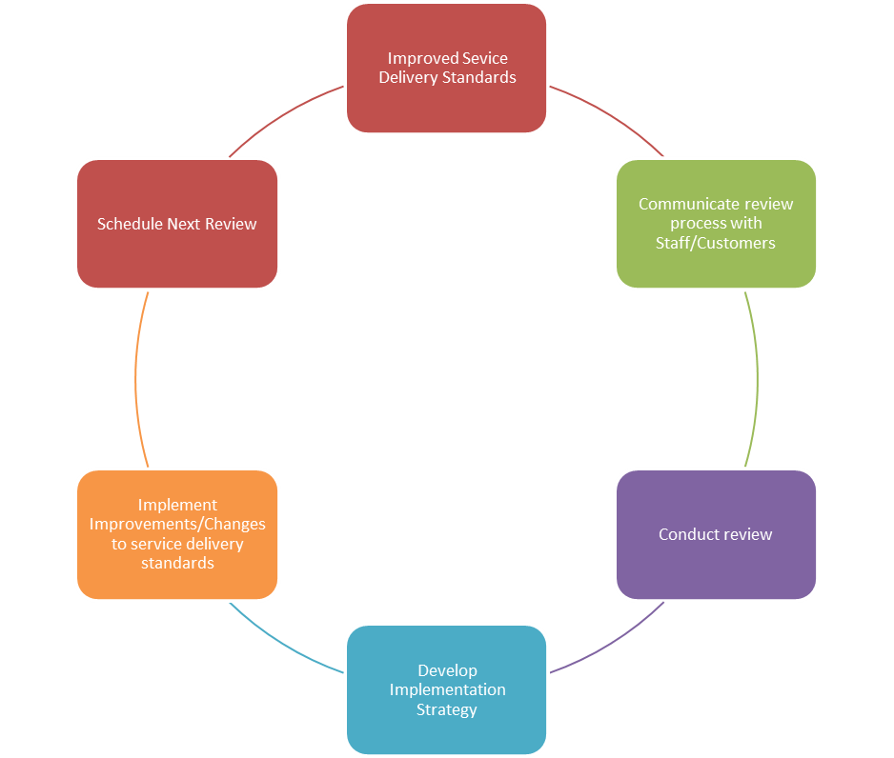
Review process
Notes:
Trainer shows slide and students discuss the process. Trainer highlights the continual improvement cycle and explains that it is repeated.
Trainer reminds students of work project and due date.
3.2. Outline a procedure, policy and service standard that your organisation has developed and determine if there needs to be any changes to the standard. Include feedback from staff, customers, managers and suppliers if available. Explain why the item needs to be updated.

Slide 42

3.3 Allocate resources to enable the provision of identified service delivery standards
Resources can include many different areas and it is critical to have all required resources available.
Notes:
Trainer introduces the performance criterion. Trainer asks trainees to outline all of the different resources that may be required for a particular service delivery item. Students discuss if they have enough resources in their workplace to complete service delivery tasks effectively.

Slide 43

Resources for service delivery
There are many different resources to consider in service delivery, such as:
Time: if the identified service delivery standard requires a certain amount of time to be able to deliver it effectively, it is not effective to reduce this time. This may lead to inferior service delivery standards which may ultimately negatively impact on the customer experience
Training: staff members need to be trained appropriately before they are able to deliver a particular service. Training may involve written and verbal materials, demonstration, practice, observation, assessment and feedback
Notes:
Trainer goes through the slide content with students. Students discuss if they have enough time to complete their service delivery tasks. Trainer asks for examples of time allocation within their workplace setting. What training is provided for trainees in their workplace? Is it effective? How do they know it is effective?

Slide 44

Resources for service delivery
Physical resources: specialised equipment may be needed to deliver a service effectively. Access to technology and adequate space may also be required
Information: staff operating manuals, emails, technical manuals, equipment operation guidelines, and updates will also help to provide effective service delivery
Notes:
Trainer introduces the slide and asks students to discuss the resources outlined. Trainees describe their workplace setting in relation to the resources outlines and determine if there is enough and if the resources are appropriate for the service delivery tasks. Trainer asks if workplace manuals are up to date, clear, reviewed regularly, and accessible.
Activity
In groups discuss all of the resources required to deliver one aspect of service delivery in your work context.
Trainer reminds students of work project and due date.
3.3. Describe a service delivery item at your workplace and the team that delivers the service. Is there enough time, people, resources allocated to the service delivery item? Bring the information to your class and discuss with your partner.

Slide 45

3.4 Assist team members to resolve customer complaints regarding the provision of service delivery
Notes:
Trainer introduces the idea of complaints in the workplace. Trainer asks students to think about common complaints they make or receive relating to service. Trainer asks what process they follow in dealing with complaints and who assists them in the workplace. Students discuss common complaints and share experience of dealing with them in small groups.
Trainer can provide examples of common complaints and arrange some role plays using situational cards. Students pretend to be the customer/service provider and show how they would deal with the complaint. The trainer shows how a supervisor or team leader can assist in difficult situations.
Trainer takes students through the complaint process/language from the TM.

Slide 46

Assisting team members to deal with complaints
In order to help other team members deal with a complaint it is possible to:
Intervene when team members appear to be unable to resolve the situation
Support team members in their handling of complaints
Lead by example
Help team members complete an action report that may be a part of internal documentation procedures within the organisation
Notes:
Trainer explains that leading by example is the best way to train staff on how to deal with complaints. Students should identify effective steps in dealing with complaints. Trainer asks students to investigate complaint procedures from the internet and from their own workplace contexts. Trainer asks trainees to provide examples of how team leaders or supervisors can assist in dealing with complaints. Trainer asks if trainees feel comfortable to ask a supervisor or manager to support them when dealing with complaints.
Trainer reminds students of work project and due date.
3.4. Write down or show your trainer an example of a customer complaint and explain how you dealt with the complaint and supported a staff member. Did you follow organisation policies and procedures? What was the result?

Slide 47

3.5 Support team members to rectify instances of deficient service delivery
Notes:
Trainer explains that as a part of a review process or just in observation, it may become apparent that some team members are performing delivery of services at a level that is not standard. In these cases it is necessary to help team members to adjust service delivery to meet organisational standards.
In pairs, trainees discuss situations where they have delivered service below standard or where they have observed sub-standard service delivery. This could be as a customer or as a staff member. Trainer asks how they react when they observe sub-standard service delivery.

Slide 48

Implementing required standards
Some ideas for rectifying deficient service delivery could be:
Discussing the issue with the team member and drawing their attention to the problem
Providing further training through demonstration, observing other team members who are delivering the service to standard, and encouraging the staff member to practice in a controlled context until the standard is achieved
Providing access to information, training manuals, resources and other material that may help align the staff member’s service delivery meet the expected standard
Moving the staff member to other duties until the required skill level or standard is reached
Applying disciplinary procedures and counselling for team members who are unable to deliver the service to standard
Notes:
Trainer goes through the slide with trainees and trainees offer insights and personal experience of situations where they have supported or been supported by other team members to improve service delivery.
Trainer asks how trainees’ service delivery is checked and reviewed. Students decide if it is an effective and supportive process.
Trainer reminds trainees of work project and due date.
3.5 Describe a situation where a team member did not deliver service to the required standard. Explain how you supported the team member to lift their service delivery standard.

Slide 49

3.6 Monitor the extent to which service delivery standards are achieved
Notes:
Trainer presents the performance criterion and students consider service delivery targets in their workplace. Trainees provide examples of service delivery targets. In small groups they discuss if targets are met and if not what makes it difficult to achieve the targets.
As has been explored in previous units, monitoring service delivery standards is critical to ensuring consistent service delivery that meets customer and organisation standards. Monitoring needs to be regularly scheduled and based upon multiple sources of feedback or sources. Monitoring processes need to be transparent and thoroughly explained to team members before being implemented and the outlined process needs to be adhered to. Team members need to know how they are being assessed, when they are being monitored and what consequences or support is available if service targets are not being achieved.
Monitoring achievement of service level targets could be conducted in many ways including:
Using objective evaluation and assessment methods which use the service standards as a guide
Interviewing and speaking to customers formally and informally to gather their feedback regarding designated service contexts
Gathering feedback from staff/team members
Investigating complaints, compliments, incident reports and accident and damage reports
Observing team members in the identified service delivery area.
If service delivery targets are not being achieved a close examination of all evidence and feedback would be required to determine where the failure in service delivery is. This could be an isolated and minor concern or it could be a systemic failure in internal training and professional development mechanisms. The main point is to identify if targets are being met and why they are or are not being met.
Trainer reminds students of work project and due date.
3.6 Outline service delivery standards within your service area and the targets for the service delivery. Explain which targets have been met and which have not. Offer reasons why the targets have/have not been met and what can be done to maintain or develop the service delivery item..

Slide 50

3.7 Take action to address failure to meet service delivery targets
If the monitoring process highlights areas of failure in reaching service delivery targets, action needs to be taken to rectify the issues
It is critical that the action decided upon is agreed to by all staff members involved in the service item and that any action responds appropriately to the failure
Notes:
Trainer goes through slide with trainees and explains the need to take action once service delivery standards have been deemed to be sub-standard. Trainer explains that some action may be immediate and relate to smaller issues whereas some action may be more significant and long term. Trainer explains that it is important that any action taken needs to be appropriate and communicated effectively.

Slide 51

Addressing service delivery failures
Taking action to address any failures in service delivery targets could include:
Revising original procedures, processes and service standards due to them being unrealistic or due to changes in the context from when they were first developed
Allocating more resources and/or different resources to help achieve targets
Rearranging the service delivery team
Notes:
Trainer explains that there are many different actions that can be taken to rectify service delivery failures. Trainer goes through the slide with students and asks students for examples where service delivery action has been taken in their workplace. Trainees offer ideas on how they can take action to improve sub-standard service delivery. Trainer asks what process they follow.

Slide 52
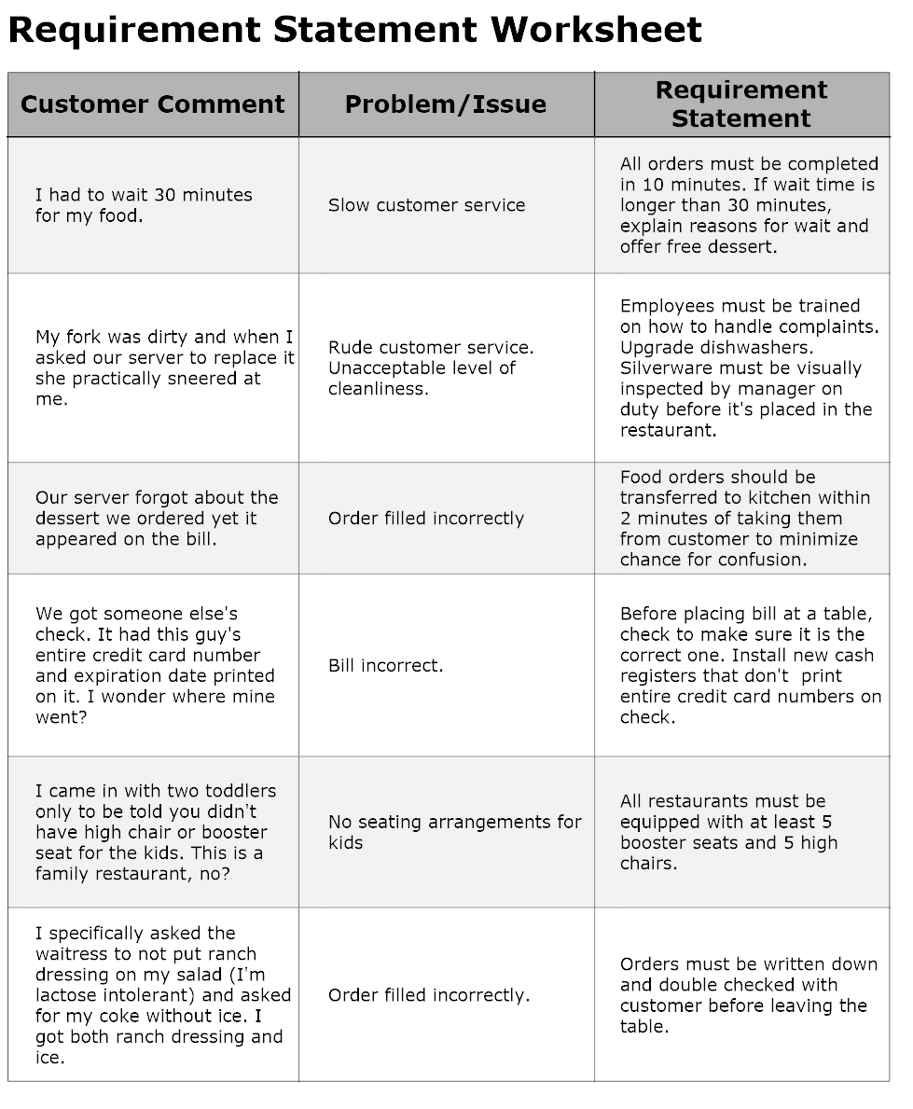
Addressing service delivery failures
Notes:
Trainer introduces slide and students read through the content. Trainer asks how trainees would implement the suggested actions in the example. Trainees give other examples from their workplace and share action that they have taken to resolve the issue.
Trainer reminds students of work project and due date.
3.7 Describe a situation where you had to take action to fix a failed service delivery situation. Discuss this with your classmates and share ideas on successful ways to address a failure.

Slide 53

3.8 Maintain records relating to service delivery
Notes:
Trainer explains that there are many records that need to be kept in any organisation. Records allow for information to be evaluated, comparisons to be made, and they provide evidence of stated objectives or targets. Records need to be maintained in an effective manner or they become meaningless and difficult to use. Maintaining records is an integral part of any successful organisation and developing systems that are easily accessible and comprehensive is important in any role.
Trainer asks students to read through the information in their TM and discuss with their partner.

Slide 54

Service delivery record examples
Some of the records that relate to service delivery could include:
Staff rosters and work schedules
Salary sheets and records of hours
Training reports, written records of personal observations, staff appraisals
Feedback surveys from customers and staff including complaint forms and compliment sheets
Incident reports
Action reports
Target reports
Notes:
Trainer explains that any record keeping system needs to be easy to use in order for it to be effective. With computer technology readily available nowadays, a filing system that uses databases or computer generated filing systems is an easy and effective option for maintaining records related to service delivery. This may be combined with a paper based system which offers back-up if the technology fails. If both paper-based and computer generated systems are used it is critical to have a system that enables both forms to updated, otherwise the system is ineffective.
It is also important to consider who and why people may need to access the records before developing a filing system.
Trainer goes through the slide with the class and students provide examples from their workplace. Trainer asks how service delivery records are maintained in their workplace. Trainer can bring examples sourced from the workplace, internet or other materials.
Trainer reminds students of work project and due date.
3.8 Bring examples of service delivery records from your workplace and show your trainer. Explain the process of maintaining the records.

Slide 55
Summary
Service teams need to:
Be monitored regularly
Be chosen and developed effectively
Have access to adequate resources to deliver service at the required standard
Provide support for team members who are not meeting service delivery standards
Be empowered to respond to failures in service delivery
Keep up to date records of service delivery and to monitor achievement or failure to meet outlined service delivery targets
Notes:
Trainer goes through the summary of the element with the class. Trainees ask any questions and trainer responds. Trainer assesses students using assessment manual questions and records answers on student assessment sheets. Trainer checks portfolios and work projects.

Slide 56
Element 4: Liaise with management regarding service delivery
Performance criteria
4.1 Discuss suggestions for improvements to service delivery with management
4.2 Discuss significant instances of failure to deliver identified service delivery standards with management
4.3 Provide operational information regarding service delivery to management
4.4 Participate in developing service delivery teams and standards for emerging and new business activities and markets
Notes:
Trainer goes through the element performance criteria with students and outlines work projects that will be required to be completed.

Slide 57

4.1 Discuss suggestions for improvements to service delivery with management
Notes:
Trainer introduces slide and explains that planning for discussions with management are important. Trainees need to have all the relevant information, evidence and possible solutions ready to share with management. Trainer can draw upon communication ideas from below and discuss with trainees how to communicate effectively and professionally. Trainees provide examples of discussions with management and how they have approached the situation.
Oral Communications
People who are successful communicators take full responsibility for success in the communication process. These people take responsibility for being certain that you understand what they are saying. They recognise that barriers to good communications exist so they speak in simple, grammatical, and understandable terms. They also give examples, ask for feedback, put what they said previously in different words, and make it easy for you to gain the true intent of their communications. However, this in no way frees the listener from responsibility from the process. Without proper listening, communication does not occur.
Listening Skills
Effective listening is active participation in a conversation. It is an activity which helps the speaker become understood. The listener must actually hear and not assume what is said. A passive listener is attentive but does nothing to assist the speaker. Active listeners sit or stand alertly, maintain eye contact with the speaker, concentrate on the speaker’s words, make verbal responses, and summarise parts of what has been said when clarity is needed.
Because there is a difference in how fast one can speak and how fast others can listen, a time lag exists in conversations. Good listeners do not daydream during this lag; they use the time to organise what is being said and to relate to the message. The listener must guard against distractions to the message. The speaker’s mannerisms, accent, dress or grooming, language style, or delivery can be distracting if the listener does not learn to tune them out. Also, listeners need to learn to avoid letting first impressions of a speaker colour their ability to hear the message.
We cannot learn anything from others if we try to do all the talking. Therefore, let speakers finish out their own sentences. Don’t interrupt them to interject your own thoughts. We need to pay attention to the tone of the words and the nonverbal cues of the speaker. Sometimes, these things undermine the actual meanings of the words themselves. For instance, someone might be telling you that he or she is not upset, but the tone or the body language might tell you otherwise.
Overall, effective listening can be expressed as follows. You should concentrate so that competing external and internal distractions are eliminated. You should probe and reflect by asking questions to seek clarification and greater understanding. You might ask “Is this what you mean?” or “Could you repeat that?” or “Are you saying that…?” Finally, you should summarise (paraphrase) and feed back to the speaker what you think you have heard. When the speaker agrees that your understanding is indeed accurate, then effective listening and effective communication have taken place.

Slide 58

Meeting with management
In discussing suggestions for improvements to service delivery with management, it is important to ensure that:
Relevant data and feedback to support changes has been gathered and is available to present if asked for
Feedback, observations, evidence and data relating to service delivery is clearly understood
Information is presented in a clear and logical manner. Using PowerPoint, charts, graphs and tables may be useful to present information
Management is able to see the need for improvements to service delivery. A comparison of desired standards and actual service delivery standard should be provided with follow-up suggestions and actions outlined
Notes:
Trainer presents slide and trainees ask any questions. Trainer asks trainees how they prepare for discussions with management and if they have been successful in sharing issues with management. What issues have they found difficult to deal with when discussing service delivery with management?

Slide 59

Meeting with management
All participants in the discussion have access to relevant information. It may be useful to make this information available before the discussion is arranged
Management is provided with an opportunity to respond to suggestions for improvement
The review process is explained to management
Costs are discussed and explained
Notes:
Trainer goes through slide with trainees. Students suggest the best way to discuss issues of service delivery with management. Trainer shares examples of service delivery issues that may be brought to the attention of management such as the need for more human resources or new equipment.
Trainer reminds trainees of work project and due date.
4.1 Bring an example of a meeting with management that related to service delivery improvements. This could include emails, meeting notes, action plans etc. Show your trainer and explain the situation.

Slide 60

4.2 Discuss significant instances of failure to deliver identified service delivery standards with management
Notes:
Trainer explains that there may be many instances of sub-standard service delivery within an organisation but not all failures to meet standards will be significant. Many instances of not meeting delivery standards can be improved easily through discussion with team members and demonstration or further training. Some instances of failure to meet delivery standards may be more serious and could be a result of many different factors. These factors could include technology failure or inadequacies, cost issues, lack of skilled staff or rapid growth in customers. Identifying failures in service delivery standards is not something that should be avoided. Being able to identify serious issues with service delivery shows that the review system is working and it is important to address the issues as soon as possible in order to rectify them. Keeping management informed enables them to deal with any potential negative effects of the sub-standard service delivery. Management can anticipate issues that could arise and they are able to plan a strategy to deal with any impacts caused by the service delivery failure.
Students provide examples of significant service delivery failures and discuss in small groups. Trainer monitors discussion and offers input as required.

Slide 61

Discussing issues with management
When meeting with management to discuss the significant failure in service delivery it may be useful to:
Thoroughly and clearly describe the context of the situation.
Involve relevant team members in the discussion with management
Offer support to any team members responsible for the failure during the discussion in order to show them that it is better to be accountable for the issue than to avoid it
Discuss solutions with management and provide a timeline for implementation of the improvements and expected outcomes of the changes
Complete an incident report to document the situation for future reference
Notes:
Trainer goes through the slide content with trainees. Trainer asks if trainees have ever performed service delivery well below standard or observed this and were they required to speak to management? Trainer elicits that supporting staff in management meetings is crucial in developing strong rapport with team members and in establishing supportive organisational culture.
Trainer asks if trainees have had to complete an incident report before.
Trainer provides example of an incident report. There are many examples online freely available.
Trainer reminds trainees of work project and due date.
4.2. Describe a time when service delivery standards were not met. Write down what the situation was and how you raised the issue with management. Provide the written outline to your trainer.

Slide 62
4.3 Provide operational information regarding service delivery to management
Notes:
Trainer explains that operational issues have a major influence on service delivery standards and identifying key operational information that relates to service delivery is an important step in the service delivery process.
Trainer asks trainees to brainstorm operational areas that can impact on service delivery: budget, scheduling, roster, annual leave/sick leave, equipment failure etc.

Slide 63

Provide management with operational information
Operational information that may be important to share with management could include:
Staff resourcing: skills, work schedule, training, numbers
Budget
Equipment and facilities: in need of refurbishment, not aligned with service delivery standards and customer expectations
Changes in technology or updated equipment that may result in a need for more training
New technology that could be available
Notes:
Trainer explains that management need to be updated on service delivery challenges and success in order to plan for future targets. Clear communication between team members, supervisors, and management enables the organisation the best opportunity to reach the service delivery targets that have been set. There are many operational issues that impact on service delivery and this information needs to be shared with management in a timely and effective manner.
Trainees discuss issues and success they have encountered in pairs and how management dealt with the information.
Trainer reminds trainees of work project and due date.
4.3. Provide an example of operational information you have shared with management in your workplace. Show your trainer and explain what the operational information is and how it is used.

Slide 64
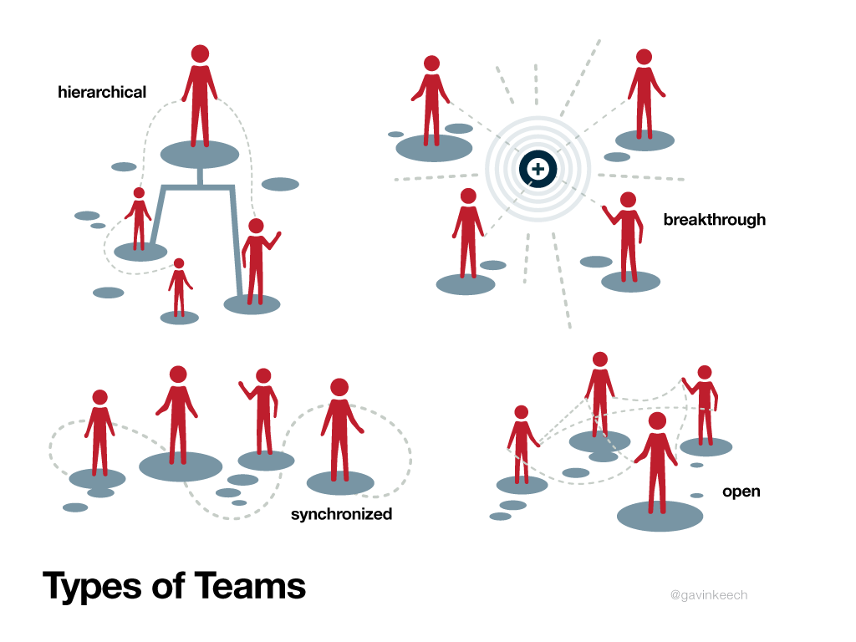
4.4 Participate in developing service delivery teams and standards for emerging and new business activities and markets
Notes:
Trainer presents slides and asks trainees to provide examples of different kinds of teams they have been a part of. Were the team structures similar to the slide examples?
Ask participants to look at the different team types and describe their service team/organisation structure.

Slide 65

Developing teams and standards for new initiatives
In developing service delivery teams and standards to respond to market opportunities and new business activities, it is critical to:
Have a clear understanding of the requirements of the new activity or emerging market and conduct research
Inform staff of the opportunity and ask for expressions of interest from staff
Gather feedback regarding current staff abilities and determine what gaps, if any, there are and what training or support may be required to address any shortfalls
Recruit new staff if required
Identify suitable staff for new activities and ask for their feedback and input
Supply information that can assist in drafting new service delivery standards that relate to the new activity
Notes:
Trainer goes through the slide with trainees and elicits the ideas of forming, norming etc from previous element. Trainer explains that identifying the new business activity and understanding the requirements of the activity is critical in developing an effective team to respond to the new activity or service delivery standard.

Slide 66

Developing teams and standards for new initiatives
In developing service delivery teams and standards to respond to market opportunities and new business activities, it is critical to:
Develop training materials and programs that will assist team members to be able to deliver the service effectively
Identify any equipment, technology or materials that may be needed for the new activity and inform management
Investigate costs related to the developing a new service delivery standard or activity
Allow enough time and resources to develop and implement the new standard or activity
Notes:
Trainer presents slide and content to trainees. Trainer elicits that team members need to have access to support materials and training to be able to implement new service standards. Trainees need to be aware of cost factors that may impact on the service delivery item as well.
Trainer reminds trainees of work project and due date. Trainer assesses trainees using assessment manual questions.
4.4. Outline a new service delivery standard or business activity that your team will be implementing. Write down what the new activity is, why it has been developed and describe the process that is required to implement the new standard or service activity.

Slide 67
Summary
In developing service teams and implementing new business ideas it is important to analyse the current business and organisational context and to base any new initiatives upon a clear understanding of organisational goals and capabilities.
Often there will be a need to develop new standards and new business activities that respond to market needs and it is important to follow a logical and inclusive process when developing new service delivery activities.
Notes:
Trainer elicits concepts and ideas from the element. Trainees ask for clarification or provide extra ideas.

Slide 68

Element 5: Lead service team delivery
Performance criteria:
5.1 Interpret stated service delivery standards for team members
5.2 Encourage team members to take advantage of opportunities to enhance service delivery
5.3 Allocate service delivery tasks to team members
5.4 Advise team members of changes to service delivery standards and/or targets
5.5 Provide feedback to team members regarding the provision of service delivery
5.6 Encourage team members to contribute feedback in regard to achievement of service and performance targets
5.7 Handle routine problems using appropriate problem-solving techniques
Notes:
Trainer introduces element and explains work project requirements.
Trainer can introduce a leadership questionnaire as a warm-up activity.
There are many available online: http://www.sagepub.com/northouseintro2e/study/resources/questionnaires/89527_03q.pdf

Slide 69

5.1 Interpret stated service delivery standards for team members
People learn in different ways but the most important aspect in sharing service delivery standards with team members, is to fully understand the standards before explaining them to other.
Notes:
Trainer can explore learning styles and ask trainees to identify their dominant learning styles. Ask, how can this affect team leadership and interpreting service delivery standards? Answer: through identification of team member strengths and weaknesses.
http://www.educationplanner.org/students/self-assessments/learning-styles.shtml
Trainer brings/or asks trainees to bring in some examples of service delivery standards and asks trainees to identify the most important parts or aspects of the procedures. Trainees discuss how they would interpret the standards for training team members.
Trainees read through example in TM.
Trainer reminds trainees of work project and due date.
5.1 Provide an example of a service standard or operating procedure and explain how you would present the item to your team. You could provide a lesson plan, a video of you delivering a training session, a power point presentation or a verbal explanation to your trainer.

Slide 70

5.2 Encourage team members to take advantage of opportunities to enhance service delivery
It is important to encourage team members to constantly look for ways to improve service delivery. The more diversity of people involved in actively seeking improved service will lead to increased customer service delivery enhancement and improvements.
Notes:
Trainer presents the slide and explains that continual improvement is a necessary part of service delivery. With so many changes in the workplace environment it is necessary to identify areas for improvement constantly.
Trainer asks students to identify any ideas that they have suggested to improve service delivery in their workplace. Trainees discuss with the class.

Slide 71

Opportunities to enhance service delivery
There are many opportunities for team members to enhance service delivery and it is important to encourage staff to look for ways to improve the service delivery by:
Providing incentives or rewards for enhancing service
Motivating team members
Identifying and providing examples of opportunities where team members can deliver high levels of customer service
Encouraging team members to look for examples of excellent customer service in industry magazines, websites, training materials, or competitor service delivery observations
Showing team members how to enhance service delivery. Leading by example
Notes:
Trainer uses the slide and TM information to explain ways to implement suggestions and improvements for service delivery. Trainees identify aspects of improvement that they have seen or implemented in the workplace. Trainees discuss in small groups service teams that they have been involved with that were successful or unsuccessful at implementing improvements. How do trainees support other team members in implementing improvements to service delivery?
Trainer reminds trainee of work project and due date.
5.2. Provide your trainer with three examples of information or materials that you have researched from the internet, competitor service delivery, industry magazines, industry associations or internal feedback surveys, which have assisted in improving service delivery within your service team.

Slide 72

5.3 Allocate service delivery tasks to team members
It is not effective to give staff members tasks that they are unable to perform. This can result in frustration and anger amongst team members. In allocate service delivery tasks to team members, it is important to:
Understand clearly what the task is
Be confident that the staff member can complete the task
Include team members in the allocation process in order to engage them
Make sure there are enough resources and time to complete the task
Clearly inform team members in advance about newly allocated tasks
Provide opportunities for feedback and support as required
Notes:
Trainer explains that in order to effectively allocate service delivery tasks to team members, there must be a good understanding of individual members’ skills and attributes. Some team members may enjoy doing certain service delivery than others so it is important to match the team member to the service delivery task that they enjoy, are good at, or want to try. Sometimes it is an effective strategy to change team member service delivery tasks in order to motivate them and challenge them.
Trainer presents slide to the class and trainees discuss how teams are allocated service delivery tasks in their organisations.
Trainer reminds trainees of work project and due date.
5.3. Provide an example of a spread sheet that shows service delivery activities designated for service team members. This could be a roster, schedule or training/skills matrix.

Slide 73

5.4 Advise team members of changes to service delivery standards and/or targets
Notes:
Trainer explains that communication is an integral part of any successful team and it is important to advise team members when changes occur to service delivery standards or targets. Changes to service delivery standards may require extra training and this would have to be arranged as well. The most important task is to ensure that all staff members affected are aware of the changes in order for the team to be able to continue to deliver service at the required standard.
Trainees brainstorm how changes to service standards are communicated in their workplace.

Slide 74

Communicating changes to staff members
There are many ways that team members could be advised of service delivery changes including:
Emailing team members and asking for confirmation of email receipt
Writing notes and putting on the staff notice board, newsletters
Arranging a team meeting
Phoning or text messaging team members if urgent
Meeting with staff members individually
Asking a team member to pass on information to others
A combination of the above
Notes:
Trainer goes through the slide with trainees and asks them to identify the most useful ways of communication changes. Students discuss their ideas regarding communication and provide examples of both effective and ineffective communication.
Trainer could play ‘Chinese Whispers’ where a sentence is given to one trainee and whispered in another trainee’s ear and repeated to other group members. The idea is to show how difficult oral communication can be.
Trainer reminds trainees of work project and due date.
5.4. Provide an example of a memo, email or meeting agenda which outlines changes to service delivery standards.

Slide 75

5.5 Provide feedback to team members regarding the provision of service delivery
Providing feedback to team members about their performance is an important part of a continuous improvement process but it must be conducted in a constructive and supportive manner.
Notes:
Trainer introduces the slide. Trainer asks students how they feel when they receive negative feedback from a customer or staff member. Students discuss in pairs and share with the class.
Trainer asks trainees to write down different forms of feedback that can be given or received in the workplace.

Slide 76

Feedback examples
Feedback to team members could include:
Praise, acknowledgement of good service, and rewarding service delivery efforts. This could be for individual team members or for the team as a whole
Advising team members when they are not producing service delivery to the standard or levels required
Monitoring implementation of feedback by team members
Sharing customer compliments and complaints
Notes:
Trainer presents the slide and asks students to discuss feedback they have received that corresponds to examples from the slide.

Slide 77

Forms of feedback
Feedback could be provided to team members:
Individually
Publically in staff newsletters or at staff/team meetings
Regular recognition ceremonies or events
Via email or notes
Verbally or written
As received or at designated and scheduled times
Notes:
Trainer asks trainees to describe feedback opportunities in their workplace. How do they receive complaints or compliments? Is there a reward and recognition program?
There are many examples of feedback techniques online. Trainer can select and introduce to the class: https://www.cabrillo.edu/services/jobs/pdfs/giving-feedback.pdf
Trainer reminds trainees of work project and due date.
5.5 Outline and demonstrate to your trainer an example of when you have provided feedback to a team member about their service delivery performance. Explain what the feedback was, how you delivered the feedback and the response from the team member.

Slide 78

5.6 Encourage team members to contribute feedback in regard to achievement of service and performance targets
Notes:
Trainer explains that in order to obtain honest feedback from team members, it is important to make sure that team members feel confident that their feedback will be listened to and respected otherwise they will not feel comfortable to share their ideas. It is important to encourage a feedback culture within service delivery teams, where team members are able to openly provide feedback about service delivery issues. This can be encouraged through:
Organising regular meetings where team members can share ideas, issues and information pertaining to their job tasks
Showing staff that their feedback is important and respected whether it is negative or positive
Acting upon feedback received and communicating any actions taken to team members
Taking feedback to management and supporting team member contributions.

Slide 79

Encouraging a positive feedback experience
Prepare what you intend to share. Think about it before you share feedback
Be specific. Give examples and provide evidence of target achievement
Limit the focus and don’t try to raise too much at once
Be honest and professional
Try to avoid strong emotions
Listen
There are many things to think about in providing effective and professional feedback. Some general rules could include:
Make the experience positive and solutions focused
Be timely, don’t wait too long after the event or situation to provide feedback
Provide regular opportunities for team members to provide feedback
Notes:
Trainer presents slides and trainees decide which are the most important points in giving feedback. Trainees discuss examples when they have provided feedback about service delivery in the workplace or as a customer. What are some potential challenges when providing feedback?
Trainer reminds trainees of work project and due date.
5.6 Provide your trainer with three examples of feedback collected from team members regarding service delivery. These could be emails, letters, notes, records of discussions or meeting notes.

Slide 80

5.7 Handle routine problems using appropriate problem-solving techniques
In dealing with routine problems it is possible to follow a procedure including:
Identification of the problem
Listening carefully and trying to understand the true nature of the issue
Considering options for resolving the issue
Making a decision
Reviewing the decision
Reporting the problem and resolution to management if required
Notes:
Trainer presents the slide and asks students to discuss in small groups problems that they have experienced in service delivery and what they did to address the issues.
Could they solve the problem on their own or did they need support?

Slide 81
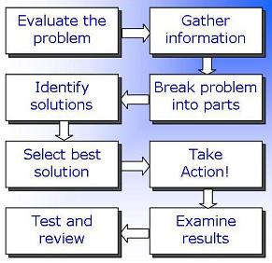
Problem-solving process
Notes:
Trainer presents the problem solving process and trainees describe if they follow a similar process. Trainer can bring or ask trainees for examples of problems and other trainees describe how they would solve them.
Trainer presents some problem-solving activities for the class: there are some good examples online such as: http://www.learningforlife.org/exploring-resources/99-720/x09.pdf
Trainer reminds trainees of work project and due date.
5.7 Provide your trainer with two examples of routine problems that you dealt with at your workplace. Outline the process you employed to deal with the problems and the result of any actions taken.

